Slide 1

Data governance

Slide 2
General Data Protection Regulation (GDPR)
History of the GDPR
The right to privacy is part of the 1950 European Convention on Human Rights, which states, “Everyone has the right to respect for his private and family life, his home and his correspondence.”
The GDPR entered into force in 2016 after passing European Parliament, and as of May 25, 2018, all organizations were required to be compliant.

Slide 3
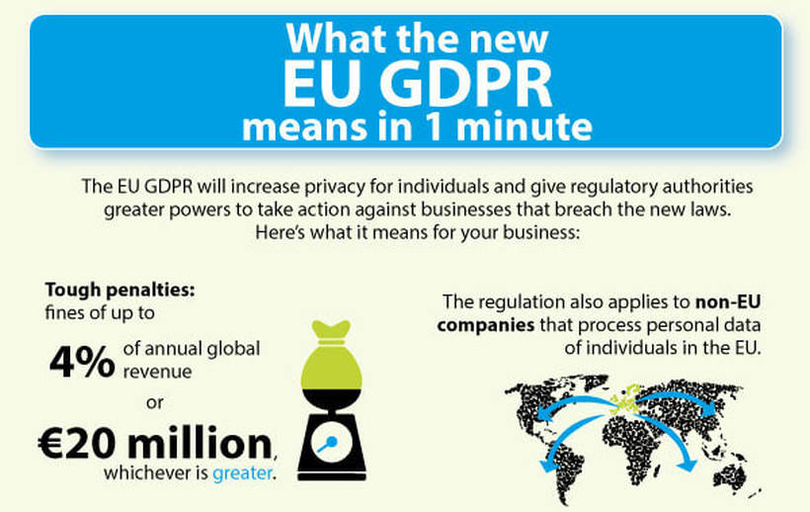

Slide 4
Terms and definitions
Personal data is any information that relates to an individual who can be directly or indirectly identified.
Names and email addresses are obviously personal data.
Location information, ethnicity, gender, biometric data, religious beliefs, web cookies, and political opinions can also be personal data.

Slide 5


Slide 6
Data protection principles
Lawfulness, fairness and transparency
Purpose limitation
Data minimization
Accuracy
Storage limitation
Integrity and confidentiality
Accountability

Slide 7
Data protection principles
Lawfulness, fairness and transparency — Processing must be lawful, fair, and transparent to the data subject.
Purpose limitation — You must process data for the legitimate purposes specified explicitly to the data subject when you collected it.
Data minimization — You should collect and process only as much data as absolutely necessary for the purposes specified.
Accuracy — You must keep personal data accurate and up to date.
Storage limitation — You may only store personally identifying data for as long as necessary for the specified purpose.
Integrity and confidentiality — Processing must be done in such a way as to ensure appropriate security, integrity, and confidentiality (e.g. by using encryption).
Accountability — The data controller is responsible for being able to demonstrate GDPR compliance with all of these principles.

Slide 8
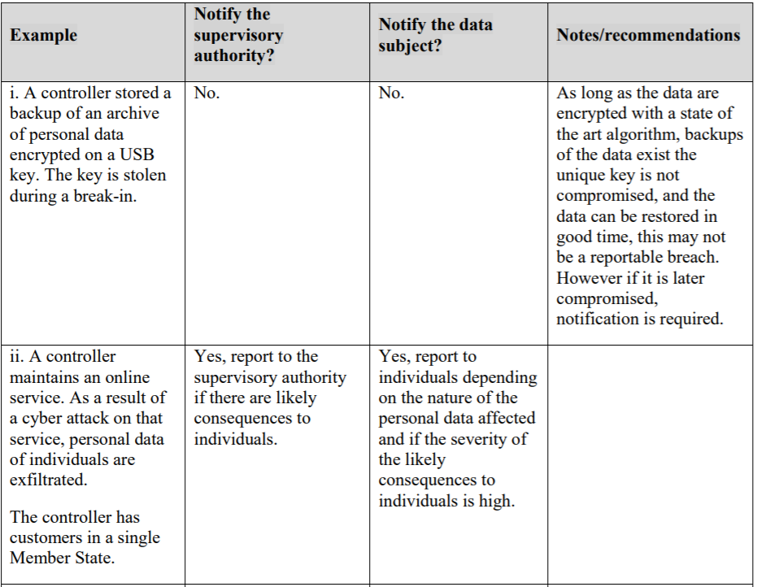
Personal data breach

Slide 9


Biggest GDPR Fines
Marriot International Inc.
In November 2018, Marriot International notified Information Commissioner’s Office(ICO) – the UK data protection regulatory body –
about a cyber-attack, which affected approximately 339 million guest records.
Personal data, including payment details and passport numbers, of around 30 million records related to the European Economic Area (EEA) residents and 7 million related to UK residents were exposed.
The attack began in 2014 in Starwood Hotels’ records, which was later acquired by Marriot in 2016.
Marriot discovered the hack in September 2018 but waited till November to report it, which is a violation of GDPR.
The Regulation requires the data controllers to report a data breach within 72 hours of becoming aware of it.
On top of that, ICO’s investigation uncovered that Marriot did not take enough measures to ensure safety when it bought Starwood.
ICO fined the hospitality company £99,200,396 for the violation.

Slide 10

British Airways
In September 2018, British Airways (BA) reported ICO of a breach of personal data of approximately 500, 000 of its users.
The hackers stole user data, including names, addresses, credit card details, and booking details of passengers after diverting users to a fraudulent website.
Even though BA reported the incident, ICO found in its investigation that the poor security management caused the leak.
In July 2019, they fined BA with a whopping £183.39 million.

Slide 11


Google and CNIL(National Commission on Informatics and Liberty)
On January 21, 2019, France’s CNIL fined Google €50 million for failing to get valid consent from the users for personalized ads.
CNIL found that the tech giant violated Articles 12 and 13, i.e., lack of transparency.
Google failed to inform users before processing their personal data. Another violation was of Article 5, i.e., the legal basis of processing.
The company was unable to prove a lawful basis for processing. The consent request was not specific.

